Slide 1
Fake job listing detection
Presented by
Harthik dhondi -18b41a0510
Charitha gujarathi -18b41a0517
Sumasri jessu -18b41a0520
Manish pawar -18b41a0530
Under the guidance of
Mrs. m. swarnaja
Asst. prof cse.

Slide 2

Index
Abstract
introduction
Objective
Working Principle
Natural Language processing
Algorithms
Environment and Tools
Conclusion

Slide 3
abstract
To avoid fraudulent post for job in the internet, an automated tool using machine learning based classification techniques is proposed.
Different classifiers are used for checking fraudulent post in the web and the results of those classifiers are compared for identifying the best employment scam detection model. It helps in detecting fake job posts from an enormous number of posts
Two major types of classifiers, such as single classifier and ensemble classifiers are considered for fraudulent job posts detection. However, experimental results indicate that ensemble classifiers are the best classification to detect scams over the single classifiers.

Slide 4

Introduction
Employment scam is one of the serious issues in recent times.
In recent days, many companies prefer to post their vacancies online so that these can be accessed easily and timely by the job seekers.
Here we come across many fake job postings in various companies.

Slide 5

objective
This project aims to create a classifier that will have the capability to identify fake and real jobs.
To avoid fraudulent post for job in the internet an automated tool using machine learning based classification techniques.

Slide 6
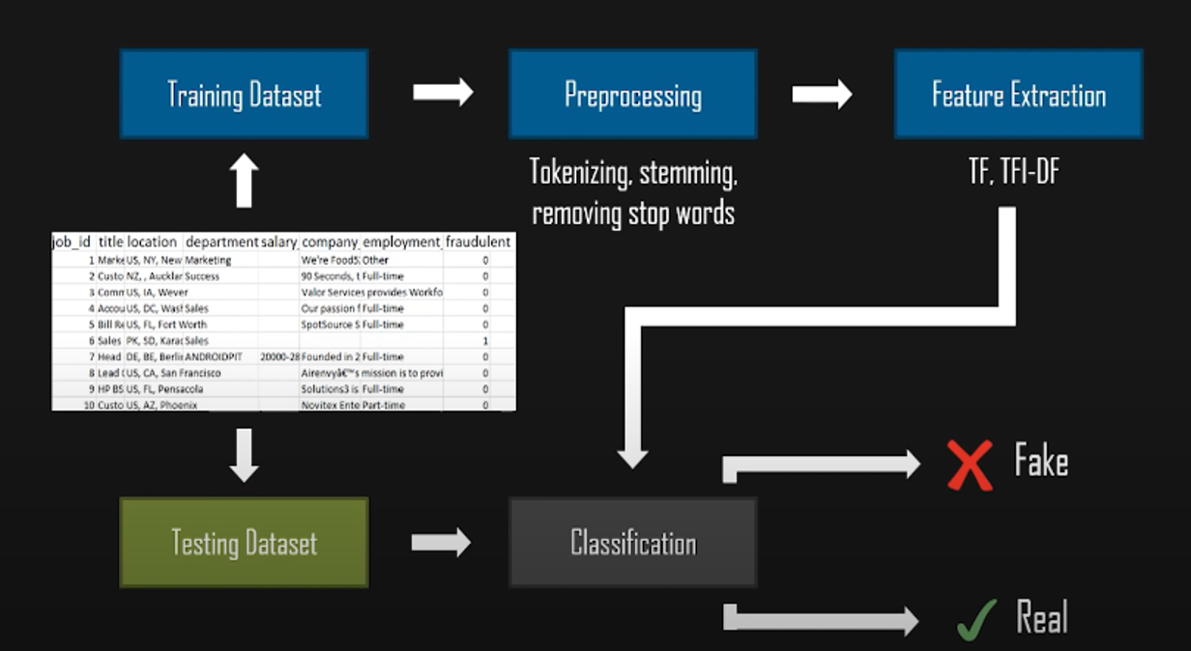
Working principle

Slide 7
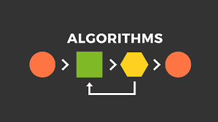
algorithms
To predict a fake job accurately we should use different types of algorithms.
Some of the majorly used algorithms are :
K-Nearest neighbor algorithm
Decision tree algorithm

Slide 8
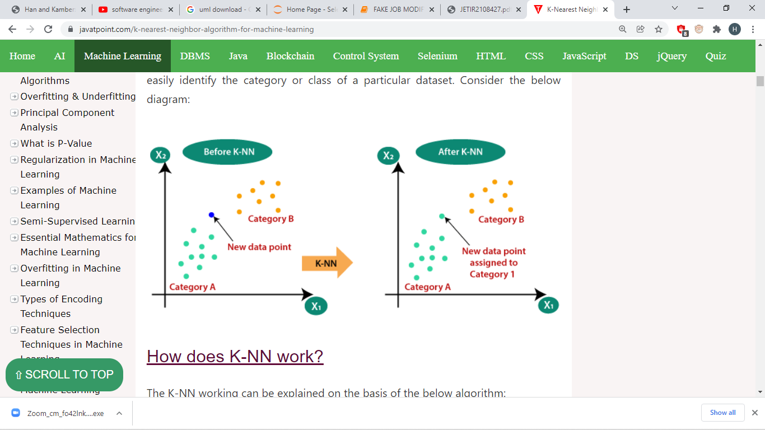
K-Nearest neighbor algorithm
K-NN algorithm stores all the available data and classifies a new data point based on the similarity.
This means when new data appears then it can be easily classified into a well suite category by using K- NN algorithm.

Slide 9
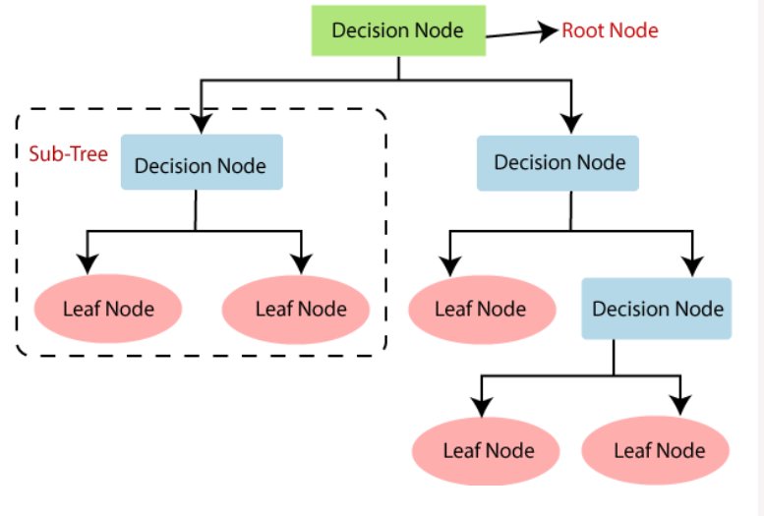
Decision tree algorithm
Decision Tree is a Supervised learning technique that can be used for both classification and Regression problems.
In a Decision tree, there are two nodes, which are the Decision Node and Leaf Node.
Decision nodes are used to make any decision and have multiple branches, whereas Leaf nodes are the output of those decisions and do not contain any further branches.

Slide 10


Environment and Tools
Language : machine learning using python
Libraries :
Numpy: NumPy is a general-purpose array-processing package. It provides a high-performance multidimensional array object, and tools for working with these arrays.
Pandas: Pandas is an open-source Python Library providing high-performance data manipulation and analysis tool using its powerful data structures.
Matplotlib: Matplotlib is a Python 2D plotting library which produces publication quality figures in a variety of hardcopy formats and interactive environments across platforms.

Slide 11

conclusion
Fake job detection will guide job-seekers to get only legitimate offers from companies.

